Slide 1
Web Mining – Twitter
Gustav Sternelöv

Slide 2
What is Twitter?
Social network, launched in 2006
Tweets, maximum 140 characters
1.3 billion registered users
320 million monthly active users
On average 303 million tweets/day (January 2016)

Slide 3
Access Twitter data
Two public API:s
Twitter REST API
Search against a sample of tweets published in the past 7 days
Streaming API
Tweets as they are tweeted, no sampling
R packages for easy access (twitteR, streamR)
Notes:
Twitter REST API:
Follower data, profile data, tweets
Limitation of requests
Searches against a sample of tweets
Streaming API
Tweets as they are tweeted
No sampling
Public stream and user stream
Recieve tweets depending on language, user/users, words/hashtags or location

Slide 4
The use of tweets
Predict real world outcomes
Presidential elections
Box-office revenues for movies
Analyze sentiments about presidential candidates
Detect earthquakes
Learn about public reactions on an outbreak of a disease

Slide 5
The Ebola outbreak in tweets
Two aims
The use of Twitter as a real-time method of Ebola outbreak surveillance to monitor information spread
Examine content of public knowledge and attitude
Tweets in English about Ebola (July 24 – August 1, 2014)
42,236 tweets (16,499 unique, 25,737 RTs)

Slide 6
Mining of tweets – Step 1
Build a tweet corpus
Example of keywords:
#Ebola, #EbolaOutbreak, #EbolaVirus, #EbolaFacts.
Information received from tweets:
Content, time stamp, geographic location, user name, message type (unique or RT) and number of followers

Slide 7
Mining of tweets – Step 2
Text cleaning
Remove non-standard or special characters (”, ´, ’, ;, ^, @)
Spaces, www, http and similar parts of the tweets also removed
Text Transformation
Content is represented as a vector of features
Individual words has the frequencies of occurrences as feature
Other features: N-grams and numeric features
Notes:
* Tweets are noisy due to use of a variety of languages, formats/signs, unstructured grammar and and unofficial abbrevations.
-> Need for text cleaning
* Simplest features are the individual words composing the tweet, and the associated feature values are the frequencies of word occurrences in the tweet.

Slide 8
Mining of tweets – Step 2, cont.
N-grams
A subsequence of N items
An example: ”What is Ebola?”
3 unigrams: ” What”, ” is”, ”Ebola”
2 bigrams: ” What is”, ” is Ebola”
1 trigram: ” What is Ebola”
Each generated unigram, bigram, trigram and so on is an attribute
Notes:
An N-gram is a subsequence of N items in a given sequence, the sequence can be anything from characters to words.
Unigram – A single word.
Bigram – A sequence of two words
Each uni-, bi and trigram generated is considered one attribute

Slide 9
Mining of tweets – Step 3
Dimensionallity reduction
Two methods: Removal of stop words and stemming
Stop words
Common words with little information (”the”, ”to”)
Stemming
Identify a word root and remove suffices and prefixes from different word forms
Porter’s Algorithm
Notes:
Stop words: Words which have little information content and are unlikely to help with text mining -> Are therefore removed
Stop words within frases are in most cases retained (”to the”, a bigram, can also be removed)
Stemming has the disadvantage of discarding linguistic information
Reduces the set of words -> Reduced dimensionality

Slide 10
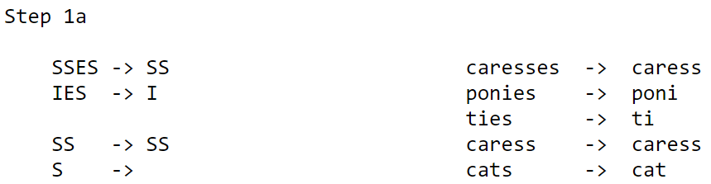
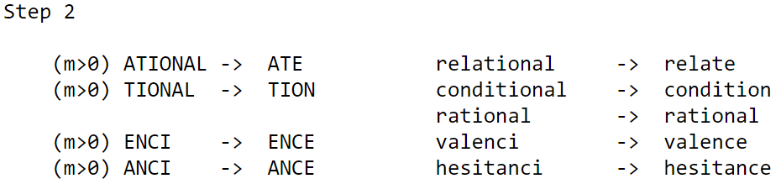
Mining of tweets – Step 3, cont.
Porter’s algorithm
One of the most common approaches for stemming
Notes:
Are different types of stemming algorithms, one of the most common are Porter’s algorithm.
Step by step, removes suffixes to bring variant forms of a word together

Slide 11
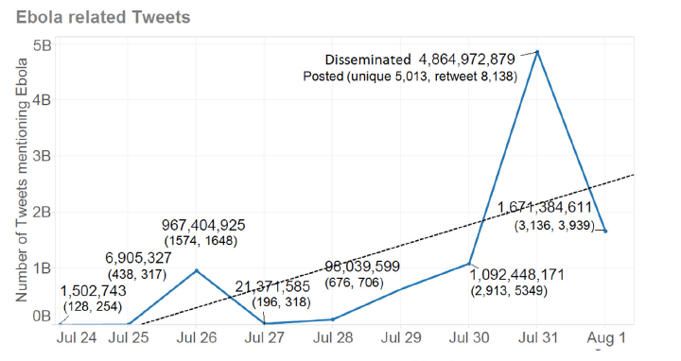
Mining of tweets – Step 4
Analyze data – The Ebola outbreak
Time-series to analyze the number of tweets
Notes:
Time-series for analyzing the increase of tweets that mentioned Ebola.
It is clear that the number of tweets mentioning Ebola increased rapidly during the time for the study.

Slide 12
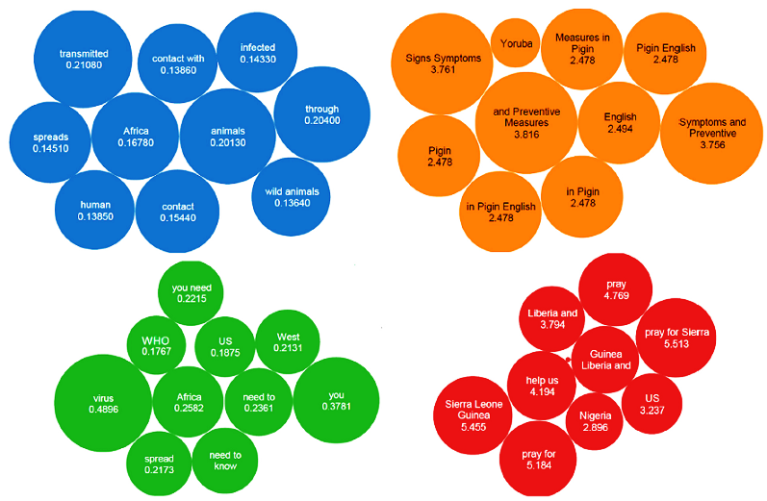
Mining of tweets – Step 4, cont.
N-grams clustered with the k-means algorithm
Notes:
N-grams were computed and clustered by K-means – Size of chart bubbles represent the relative frequency of the n-gram.
Four main public topics of concern were discussed:
Risk factors: Cause of the virus (transmission, infection) – The blue cluster
Prevention education: Health information (prevention methods, signs, symptoms) – The orange cluster
Disease trends: Spread and location (names of locations, information about spread) – The green cluster
Compassion: Prays for countries in Africa – The red cluster

Slide 13
The US presidential election in 2012 reflected in tweets
Aim:
Compare sentiments about candidates and keywords before and after the election
Tweets from October to November 2012
Total of 196,000 tweets
Example of keywords:
Candidates names, election related hashtags and candidates hashtags

Slide 14
The US presidential election in 2012 reflected in tweets, cont.
Text cleaning:
Removal of stop words, punctuation symbols etc.
Deleted all RTs
Converted emoticons to words
Sentiment analysis
Aim is to classify tweets as positive or negative
3 scoring functions (Score.polarity, Score.sentiment and Score.afinn)
Notes:
Sentiment analysis: Field of study that analyzes peoples opinons, sentiments, evaluations, appraises, attitudes and emotions towars entities. In this example sentiment polarity towars candidates and keywords.
Score.polarity: Uses a list of positive and negative opinion words or sentiment words in English. The score is computed based on the difference between the number of positve and negative words in the tweet. Words are manually selected and graded by a human judge.
Score.sentiment: Metric that uses the R package sentiment to classify the polarity (positive or negative). It uses a naive Bayes classifier using a lexicon. Score is -1, 0 or 1. Evaluates all words, not only those found in a specified list.
Score.afinn: Tweet’s score based on the AFINN list, a listof English words rated for valence with an integer between -5 and 5. Words in list manually labeled by Finn Nielsen.
Human judge in all cases

Slide 15
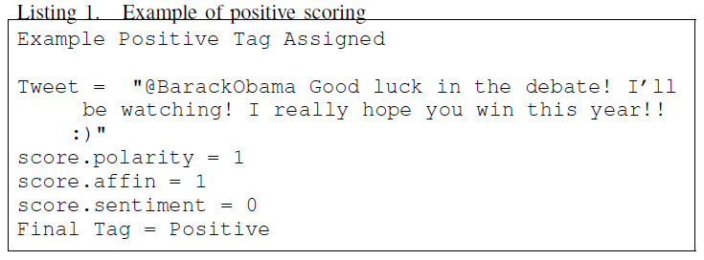
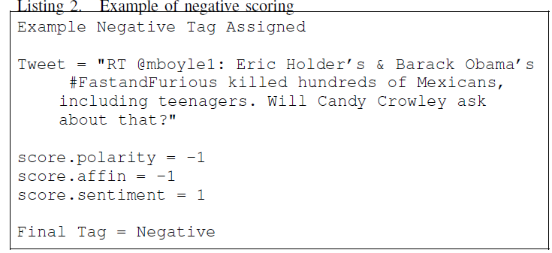
The US presidential election in 2012 reflected in tweets, cont.
Notes:
All scores normalized to take values -1, 0 or 1.
Mode between the scoring functions decides what tag a tweet is given. If all scores are different, the tweet is tagged as neutral.

Slide 16
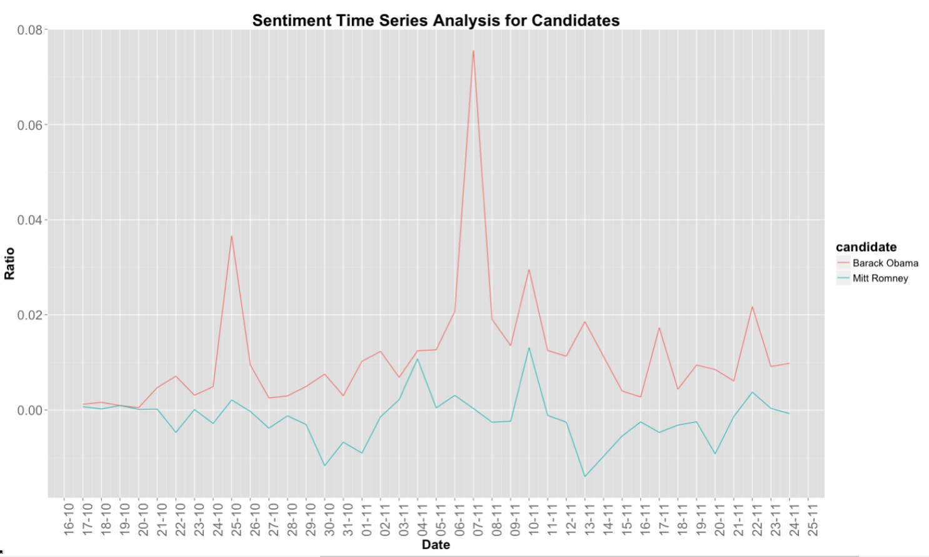
The US presidential election in 2012 reflected in tweets, cont.
Notes:
Ratio of positive tweets – negative tweets / all tweets
Never negative for Obama
Around zero/negative for Romney

Slide 17
Sources
https://about.twitter.com/company , 27/4 -16
http://uk.businessinsider.com/tweets-on-twitter-is-in-serious-decline-2016-2, 27/4- 16
http://expandedramblings.com/index.php/march-2013-by-the-numbers-a-few-amazing-twitter-stats/, 27/4- 16
https://dev.twitter.com/rest/public, 28/4 - 16
https://dev.twitter.com/streaming/overview, 28/4-16
F. Nooralahzadeh, V. Arunachalam and C. G. Chiru, "2012 Presidential Elections on Twitter -- An Analysis of How the US and French Election were Reflected in Tweets," 2013 19th International Conference on Control Systems and Computer Science, Bucharest, 2013, pp. 240-246.
Odlum, M., & Yoon, S. (2015). Major article: What can we learn about the Ebola outbreak from tweets?. AJIC: American Journal Of Infection Control, 43563-571. doi:10.1016/j.ajic.2015.02.023

